Slide 1
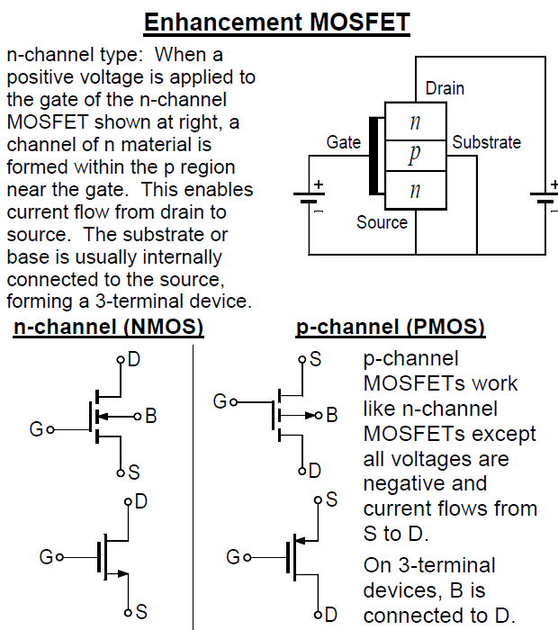

REVIEW: METAL OXIDE SILICON FIELD-EFFECT TRANSISTORS - MOSFETs
1

Slide 2
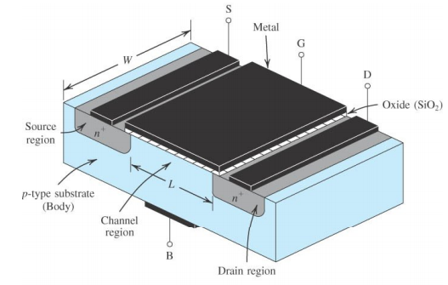
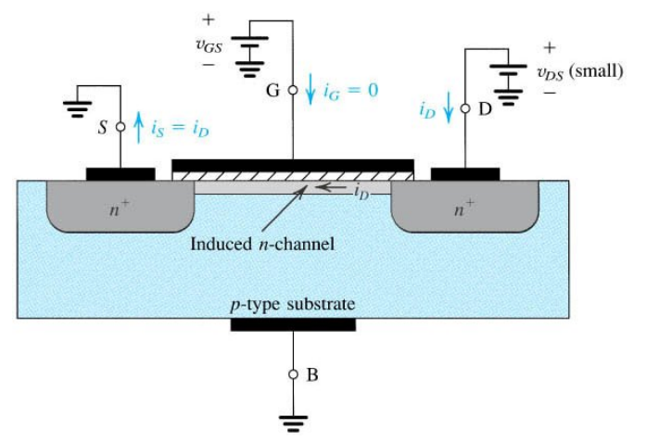

Slide 3
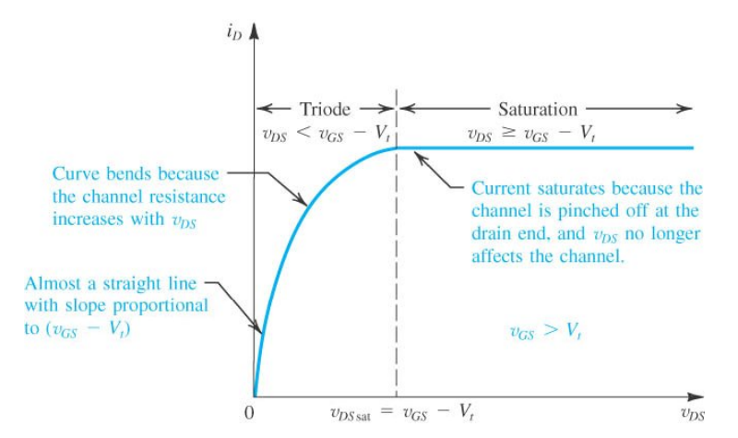
The Three Modes of Operation:
CUTOFF - The region where the gate voltage is lower than the threshhold voltage V_{t} so that no current flows through the drain.
TRIODE - The region where v_{DS} is lower than the excess gate voltage and the characteristic curve is a curve. For small signals of V_{DS}, the FET behaves like a voltage-controlled resistor. In the operating region, the characteristic curve may be thought of as a straight line, the slope of which is the inverse of the drain-to-source resistance.
SATURATION - The region where v_{DS} is greater than the excess gate voltage and the characteristic curve is a horizontal line. Drain current is a function of gate voltage v_{GS}. Drain current is constant (current saturated) with changes of v_{DS}.

Slide 4
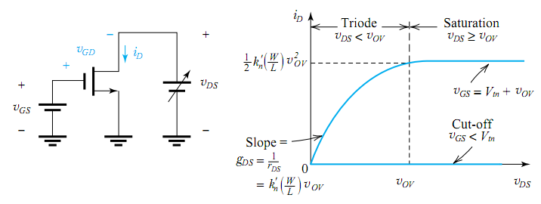
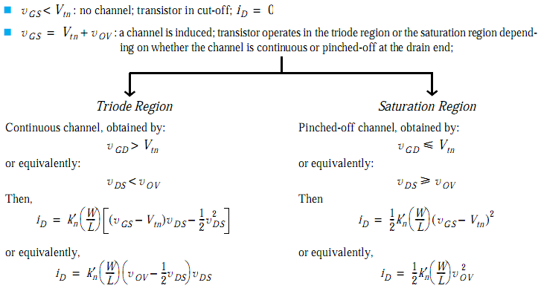

Slide 5
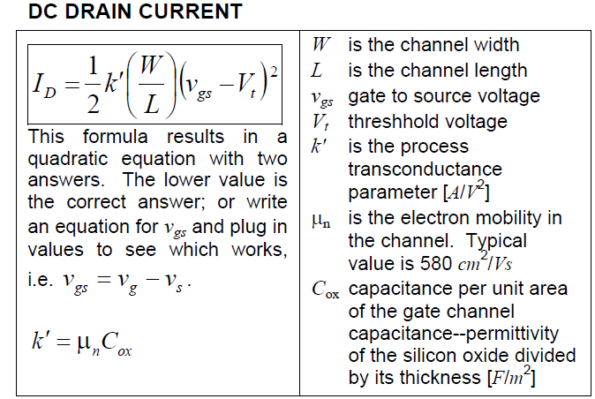
5

Slide 6
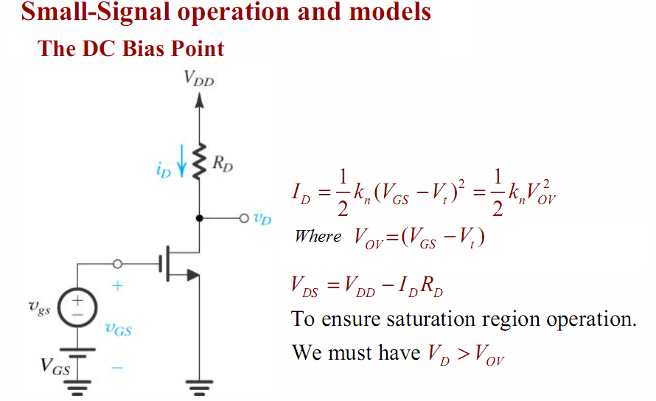

Slide 7
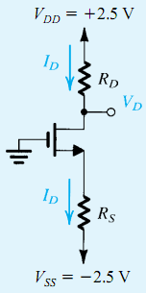
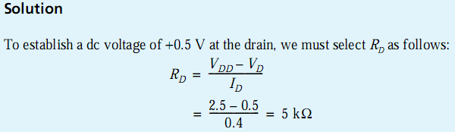
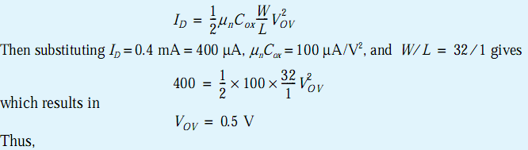

Example

Slide 8
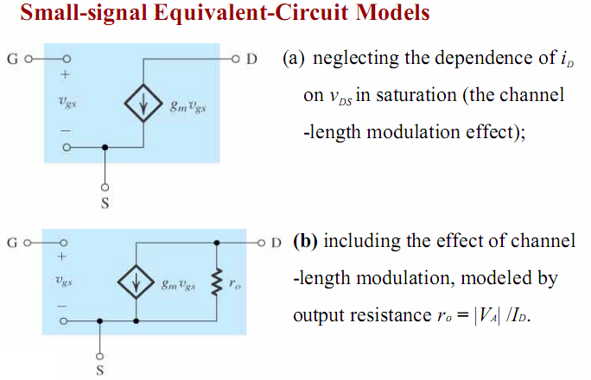
The voltage V_{A} is usually referred to
as the Early voltage

Slide 9
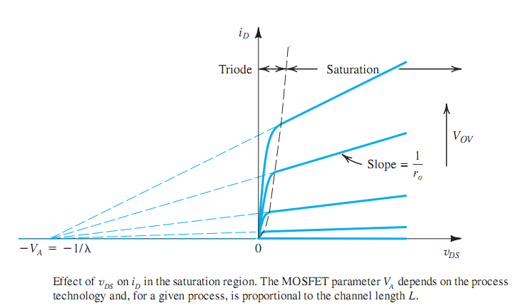
The Early voltage V_{A}

Slide 10
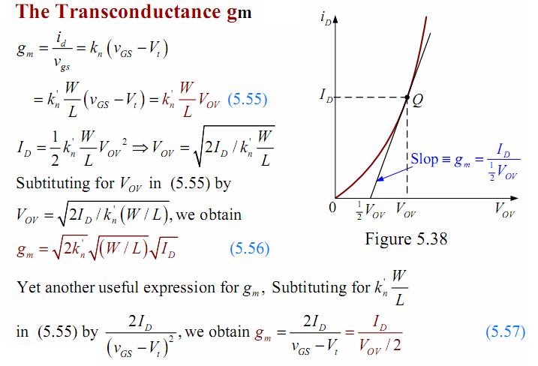

Slide 11
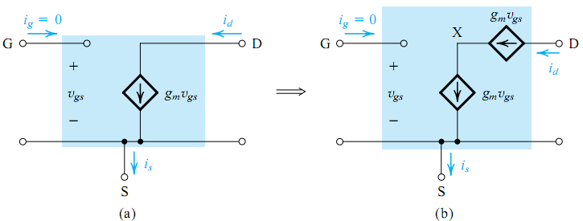
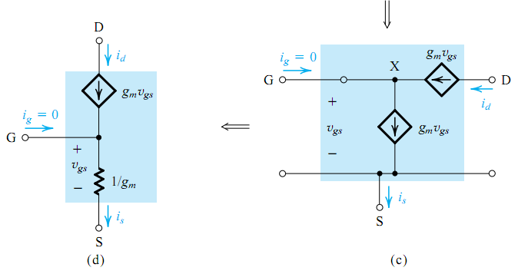
The π equivalent circuit
The T equivalent circuit

Slide 12
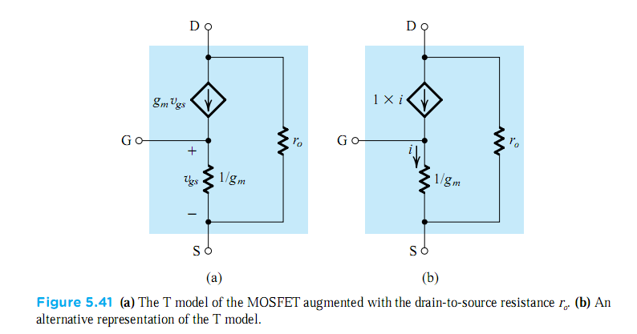

Slide 13
Question 2
1. What mode is used for amplification with MOSFET?
2. For an MOSFET with V_{t} = 1v, I_{D} = 0.64 mA,
Find voltage V_{GS} and g_{m}.
3. In question 2, if the Early voltage VA = 200v, Plot T-equivalent
circuit (T- Model) for the MOSFET.
You submit your solution not later than March 13, 2020.
You can send your solution with any format to Mr. Huy through his email nbdhuy@hcmiu.edu.vn

